Slide 1

Analysis of Goodcabs Transportation company
Agenda
1. Problem Statement
2. Goal
3. Dashboard Showcase
4. Insights

Slide 2
Problem Statement
Goodcabs, a cab service company established 2 years ago, has gained a strong foothold in the Indian market by focusing on tier 2 cities.
The management team wants to assess the performance across key metrics, including volume of trips, satisfaction rate, new and repeat passenger.

Slide 3
Goal
To design a dashboard with the provided metrics and analyze the data to gain insights on the below key points
1. Factors influencing repeat passenger rates
2. Tourism vs Business Demand Impact
3. Partnership Opportunities with Local Business

Slide 4
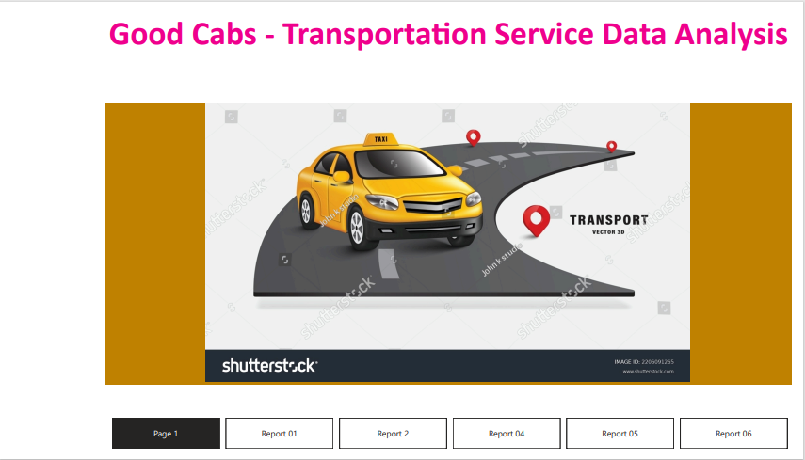
Dashboard Showcase

Slide 5
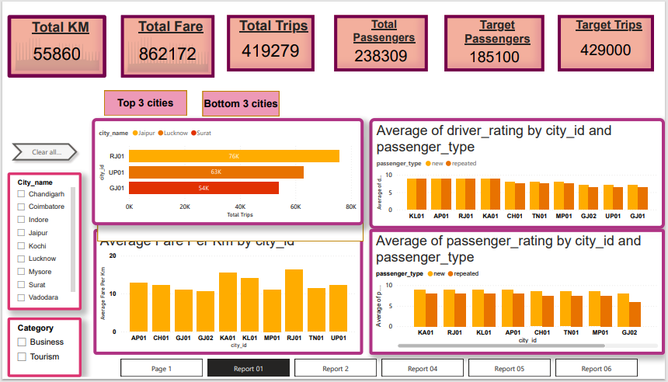
Report Page 01

Slide 6
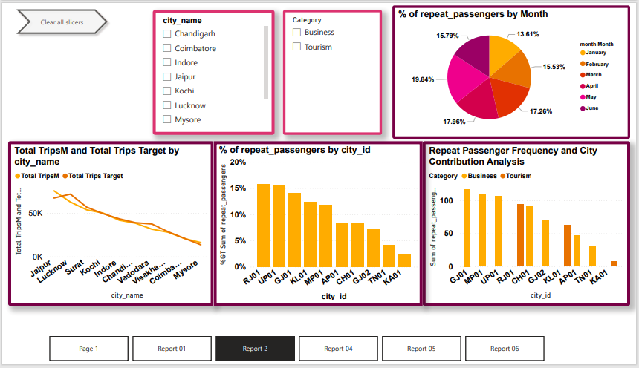
Report page 02

Slide 7
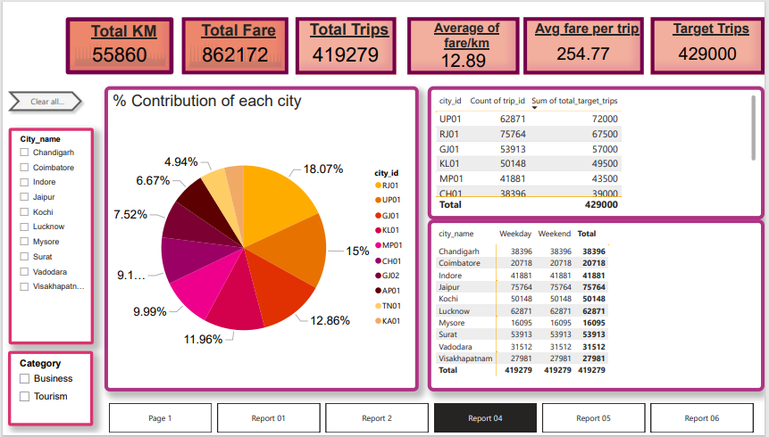
Report page 03

Slide 8
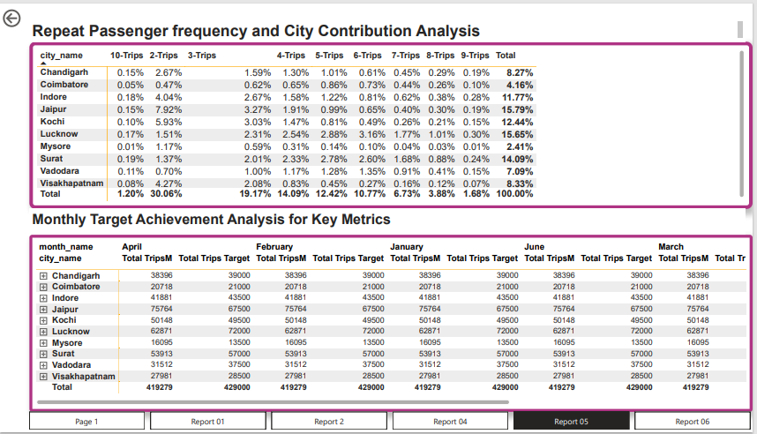
Report page 04

Slide 9
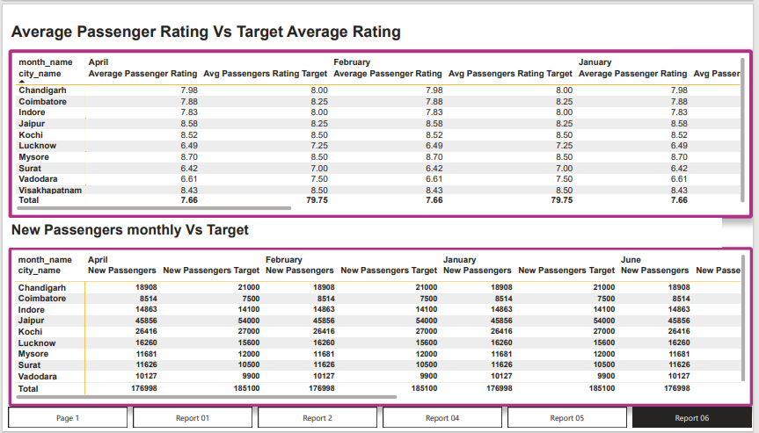
Report page 05

Slide 10
Key Insights from the report
Average Fare Per Km:
The fare per km varies by city, with a range depicted across cities like AP01, CH01, GJ01, and others.
Driver and Passenger Ratings:
Ratings are analyzed by city and passenger type (new or repeated).
Both driver and passenger ratings demonstrate significant variation between cities.
City Contribution:
Cities like RJ01 and UP01 contribute significantly to overall metrics like trips and fare revenue, while others like KA01 and AP01 contribute less.
Passenger Frequency Analysis:
Repeat passenger frequency is tracked across cities, with variations in monthly contributions.
Cities like Jaipur (RJ01) and Lucknow (UP01) have higher percentages of repeat passengers as compared to others.

Slide 11
Key Insights from the report
Total Trips and Targets:
Cities like Jaipur and Lucknow exceed their trip targets, while smaller cities like Mysore fall short.
The reports also shows trip performance monthly against set targets.
Months having Peak Demand:
April and May months shows highest number of trips. The highest number of trips are from Jaipur (Rajasthan) which is belongs tourism category.
New Passengers:
Data shows monthly acquisition of new passengers versus targets, highlighting cities like Jaipur and Kochi achieving or nearing targets, while others struggle.
Ratings vs. Targets:
Average passenger ratings are compared to target ratings. Cities like Mysore consistently achieve high ratings, while others like Surat fall short.
Trip Categories:
Trips are categorized by frequency, with a breakdown for cities showing trends in repeated usage patterns.

